Slide 1

Carbon360s
SEED ROUND · NOVEMBER 2026
A carbon marketplace where buying and selling credits is frictionless.
Now our farmers grow too.

Slide 2
Why small farmers miss out on carbon markets
Hard to reach
Poor farm records
Projects need many farms grouped together. Government rules let FPOs and developers do this.
Baselines are hard to prove without field records. OUR VIEW, TO BE TESTED
Slow independent checks
Farmer income unknown
Only BEE-accredited agencies can validate and verify. Self-certification is not allowed.
A Lok Sabha reply said no assessment of farmer income potential has been done.
Gap we see: nobody yet combines village-level trust, project development and direct buyer sales in eastern India. OUR VIEW
Sources: Outlook Business, govt carbon pilots · BEE verification agency procedure

Slide 3
Competitors: funded, but not local
Company | What they do | Funding / valuation | Gap we see (our view)
Varaha | Removal projects in India and 4 other countries; Series B about $45M | About ₹1,020 Cr (one report); $250–500M (Dealroom) | Broad portfolio; village-level trust not their stated focus
Grow Indigo | India soil-carbon credits under Verra VM0042 | $25–50M (Dealroom) | Soil carbon is complex to measure
Indigo Ag (US) | Large soil-carbon programme | $3.5B in 2020, reportedly about $200M later | Capital heavy; valuation fell
Boomitra | Soil carbon for farmers | About $11M raised (PitchBook) | Remote-sensing led; thin local presence
Sources: Varaha · Dealroom: Varaha · Dealroom: Grow Indigo · VM0042 credits · AgFunder: Indigo Ag · PitchBook: Boomitra

Slide 4
Opportunity: big land base, early market
179.4 M ha
$30–50 B
India cultivable land, 2024–25 (provisional)
India carbon market potential by 2050 at $15 a credit, across agriculture, land restoration and forests
₹194
$492.6 M
Average Indian credit price per tonne, Q1 2024
Raised by carbon-removal startups in 18 rounds, 24 months to July 2026
ASSUMPTION Our own target: a 1,000-acre pilot, then 15,000 acres by Year 3. This is not a market-size claim.
Sources: IBTimes, Lok Sabha reply · Intellecap · The Quint · NewMarketPitch

Slide 5
Our edge: local trust and access
Cooperative sector network
Village-level hiring
Rules favour grouping
Field coordinators come from the farmers' own villages, so trust is built in.
The government programme route lets FPOs and developers group many small farms.
Founder's relationship with senior leadership of a Jharkhand cooperative institution opens a path to PACS and farmer groups. Jharkhand has 12,207 cooperative societies (National Cooperative Database, July 2026).
RELATIONSHIP, NOT AN AGREEMENT
Sources: Outlook Business, programme-of-activities route · Indian Cooperative: NCD, Jul 2026

Slide 6
What we do: farm to buyer in five steps
1
Onboard
Farmers join with consent through trusted local coordinators.
2
Map
GPS plot boundaries, crops and practices are recorded.
3
Match
Each plot is checked against an approved methodology.
4
Verify
An accredited independent agency validates the project.
5
Sell and share
We sell credits to companies. Farmers and PACS get 20% of proceeds.

Slide 7
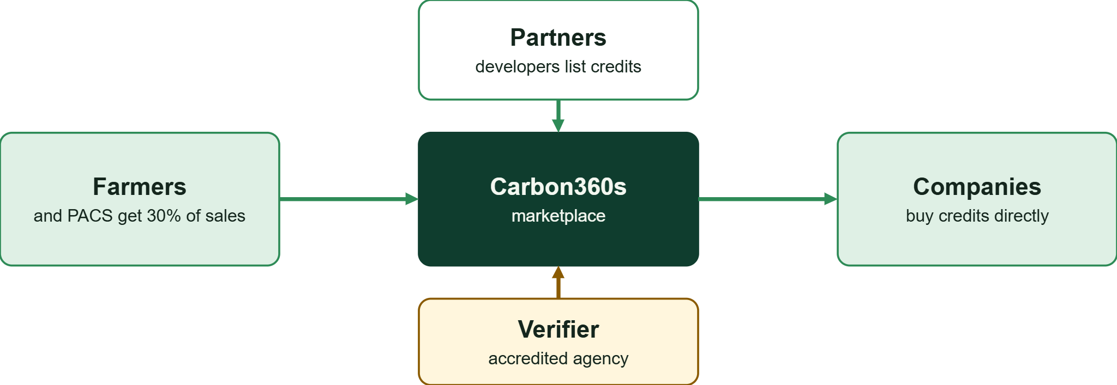
The marketplace: simple for sellers and buyers
We keep 80% of credit sales on our own projects. For partner developers we take 30% of sales if we only find the buyer, and 50% if we run the full sale process.

Slide 8
Team
Shailendra Saurav
Rudra Majumdar
Subhendra Saurav
Founder and CEO
CFO and Marketing Head
Co-founder, Farmer-side Head
Built Stock360s and Revenue360s. Ex-Data Engineer, Zensar. BE, VTU 2022.
Finance, fundraising, corporate buyers and marketing.
Farmer onboarding, village coordinators and field trust.
Sanket Pawar
Cloud and Backend Lead
Satvik Bagewadi
Frontend and DevOps Lead
Our journey: Stock360s, then Revenue360s, a live business platform now reused as the base for new products.

Slide 9
The ask: ₹3 Cr for 15%
₹20 Cr post-money (₹3 Cr ÷ 15%). Proposed release: ₹65L at closing, ₹60L at M2, ₹115L at M3, ₹60L at M4.
Use of funds | ₹ lakh | Share
Payroll with buffer | 120.0 | 40%
Field operations | 20.0 | 7%
Marketing | 12.0 | 4%
Legal and insurance | 7.0 | 2%
Registration, charging fees, business expenses | 10.0 | 3%
Office, cloud, equipment | 24.4 | 8%
Project design, validation, verification | 23.0 | 8%
Farmer practice support, expansion, working capital | 58.6 | 20%
Contingency and reserve | 25.0 | 8%
Total | 300.0 | 100%
Sources: Plan figures, not vendor quotes. The ₹58.6L line and the release split are proposals. Calculated from company budget.

Slide 10
What ₹3 Cr must earn back
We never buy land. Acres are farmland that farmers enrol. We keep 70% of sales; farmers and PACS get 30%.
Case | Credits needed | Acres enrolled | Farmers (about 2.7 acres each)
Base: ₹1,000 a credit, 2.03 credits an acre | 42,857 | 21,112 | about 7,820
Low price: ₹300, 2.03 an acre | 142,857 | 70,373 | about 26,060
Low yield: ₹1,000, 0.7 an acre | 42,857 | 61,224 | about 22,680
Both low: ₹300, 0.7 an acre | 142,857 | 204,082 | about 75,590
PROJECTION Gross recovery of ₹3 Cr in one issuance year. Running costs and verification fees come on top. Our Year 3 target of 15,000 acres is below the base-case need of about 21,100 acres, so recovering the raise from our own sales alone would take more land or partners.
Sources: The Quint: ₹194 average price, Q1 2024 · Credits per acre and ₹1,000 price are our assumptions.

Slide 11
Timeline: four milestones in 18 months
Milestone | Month | Outcome
M1 | 1 | Research dataset and software v1 complete
M2 | 2–5 | Farmers grouped, inspected and geo-tagged (1,000-acre pilot across 8–15 PACS clusters)
M3 | 5–8 | Independent validation passed, registration submitted
M4 | 7–12 | First buyer signed (conditional offtake)
After M4 | 13–18 | Farmers apply practices; monitoring and verification. First credit revenue targeted from month 18
ESTIMATES Timings are our estimates. Validation and verification by accredited agencies can run longer. Team grows to about 12 people by month 7.
Sources: BEE verification agency procedure

Slide 12
Three-year plan and revenue
 | Year 1 | Year 2 | Year 3
Acres enrolled (cumulative) | 1,000 | 5,000 | 15,000
Farmers at about 2.7 acres each | about 370 | about 1,850 | about 5,560
Credits issued in year | 0 | 700–2,030 | 3,500–10,150
Our revenue (70% of sales) | ₹0 | ₹1.5L–₹14.2L | ₹7.4L–₹71.1L
PROJECTION Low case: 0.7 credits an acre at ₹300. Base case: 2.03 credits an acre at ₹1,000. Credits are issued the year after enrolment. Commission income from partner developers is not included. Running cost is about ₹1.6–2.2 Cr a year, so credit revenue alone only breaks even in Year 4 in the base case (15,000 acres, about ₹2.1 Cr). Revenue is not our main goal here; see next slide.
Sources: The Quint: ₹194 average price, Q1 2024 · Other inputs are our assumptions.

Slide 13
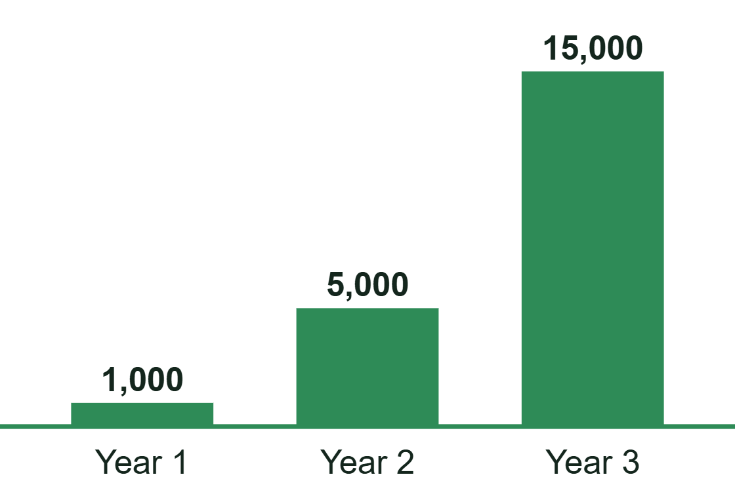
After 3 years: market capture is the goal
Acres enrolled
2 → 10 → 30
Partner aggregators and developers signed, Years 1 to 3 (target)
1 → 3 → 5
Indian states: Jharkhand, then Bihar and Odisha, then two more
₹100–250 Cr
Our Year 3 valuation ambition. Investors set the price.
TARGETS Year 1 pilot: 1,000 acres across 8–15 PACS clusters. 15,000 acres is about 0.003% of India's 443 million cultivable acres, so headroom is huge. Partners bring their own farmers, which is how we grow faster than onboarding alone. For reference: Varaha about ₹1,020 Cr (one report), Grow Indigo $25–50M (Dealroom).
Sources: India cultivable land · Varaha · Dealroom: Grow Indigo ·.

Slide 14
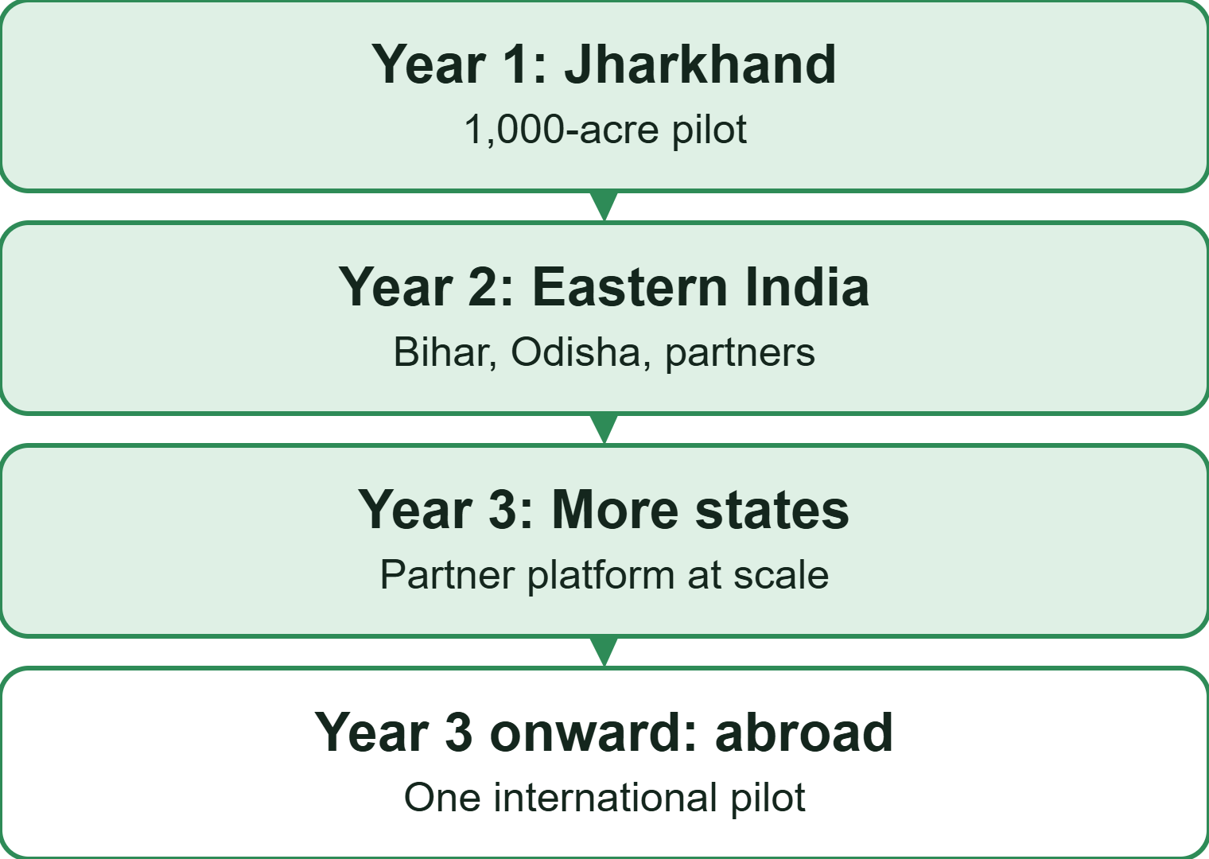
Global view: rules are moving toward groups of small farmers
EU carbon farming rules
A voluntary EU framework requires third-party verification and allows group certification for small farmers.
An EU registry is due by 27 December 2028, and the Commission has announced a buyer club for removals.
It is for EU-certified projects. Indian projects do not qualify automatically. We use it as a signal and a possible future route.
Sources: European Commission: CRCF · EUR-Lex: Regulation (EU) 2024/3012 · European Parliament summary · Taylor Wessing: buyer club

Slide 15
Risks and downsides
Plots may not qualify
Low credit price
Slow timeline
Methodology fit, baseline and additionality can reject land.
Average ₹194 in Q1 2024. Government plans to keep the CCTS price below $10.
No credits before about month 18. Independent checks can run longer.
Yield unproven
Relationship is not a contract
Funded rivals
0.7 or 2.03 credits an acre. The methodology will decide.
No signed MoU. Farmer numbers are not committed.
Varaha raised about $45M. We start small.
Marketplace cold start
Commission depends on partners
Rules can change
We need sellers and buyers at the same time.
Carbon market rules are still evolving.
Partner developers may sell elsewhere.
Not in the budget: farmer incentives beyond the ₹58.6L line, taxes and delayed buyer payments.
Sources: The Quint · Business Standard · BEE methodology

